Slide 1
The radio project
YI
A brief of the project and future proposal
Vinayak Nayak KV

Slide 2
The bininging
This project started as a passion project at YI just before I started my 2nd year of MSc. We were either planning on building a radio antenna or a spectrometer, because we wanted to introduce something new in the astro education community
We stuck with the radio because both Tonny and I felt like it would be “easier” and cooler than a spectrometer.
We did some research on what types there are and what can be done, watched tons of YouTube videos, and met Prabhu at RRI, who in the first meeting, already despised St. Joseph’s people told us we cant do it, and yet we are here

Slide 3
Over multiple visits to RRI for various purposes, we were able to see the radio setups of RRI, the horn setups specifically, we had decided to build a horn antenna but things changed (que to OG ppt)

Slide 4
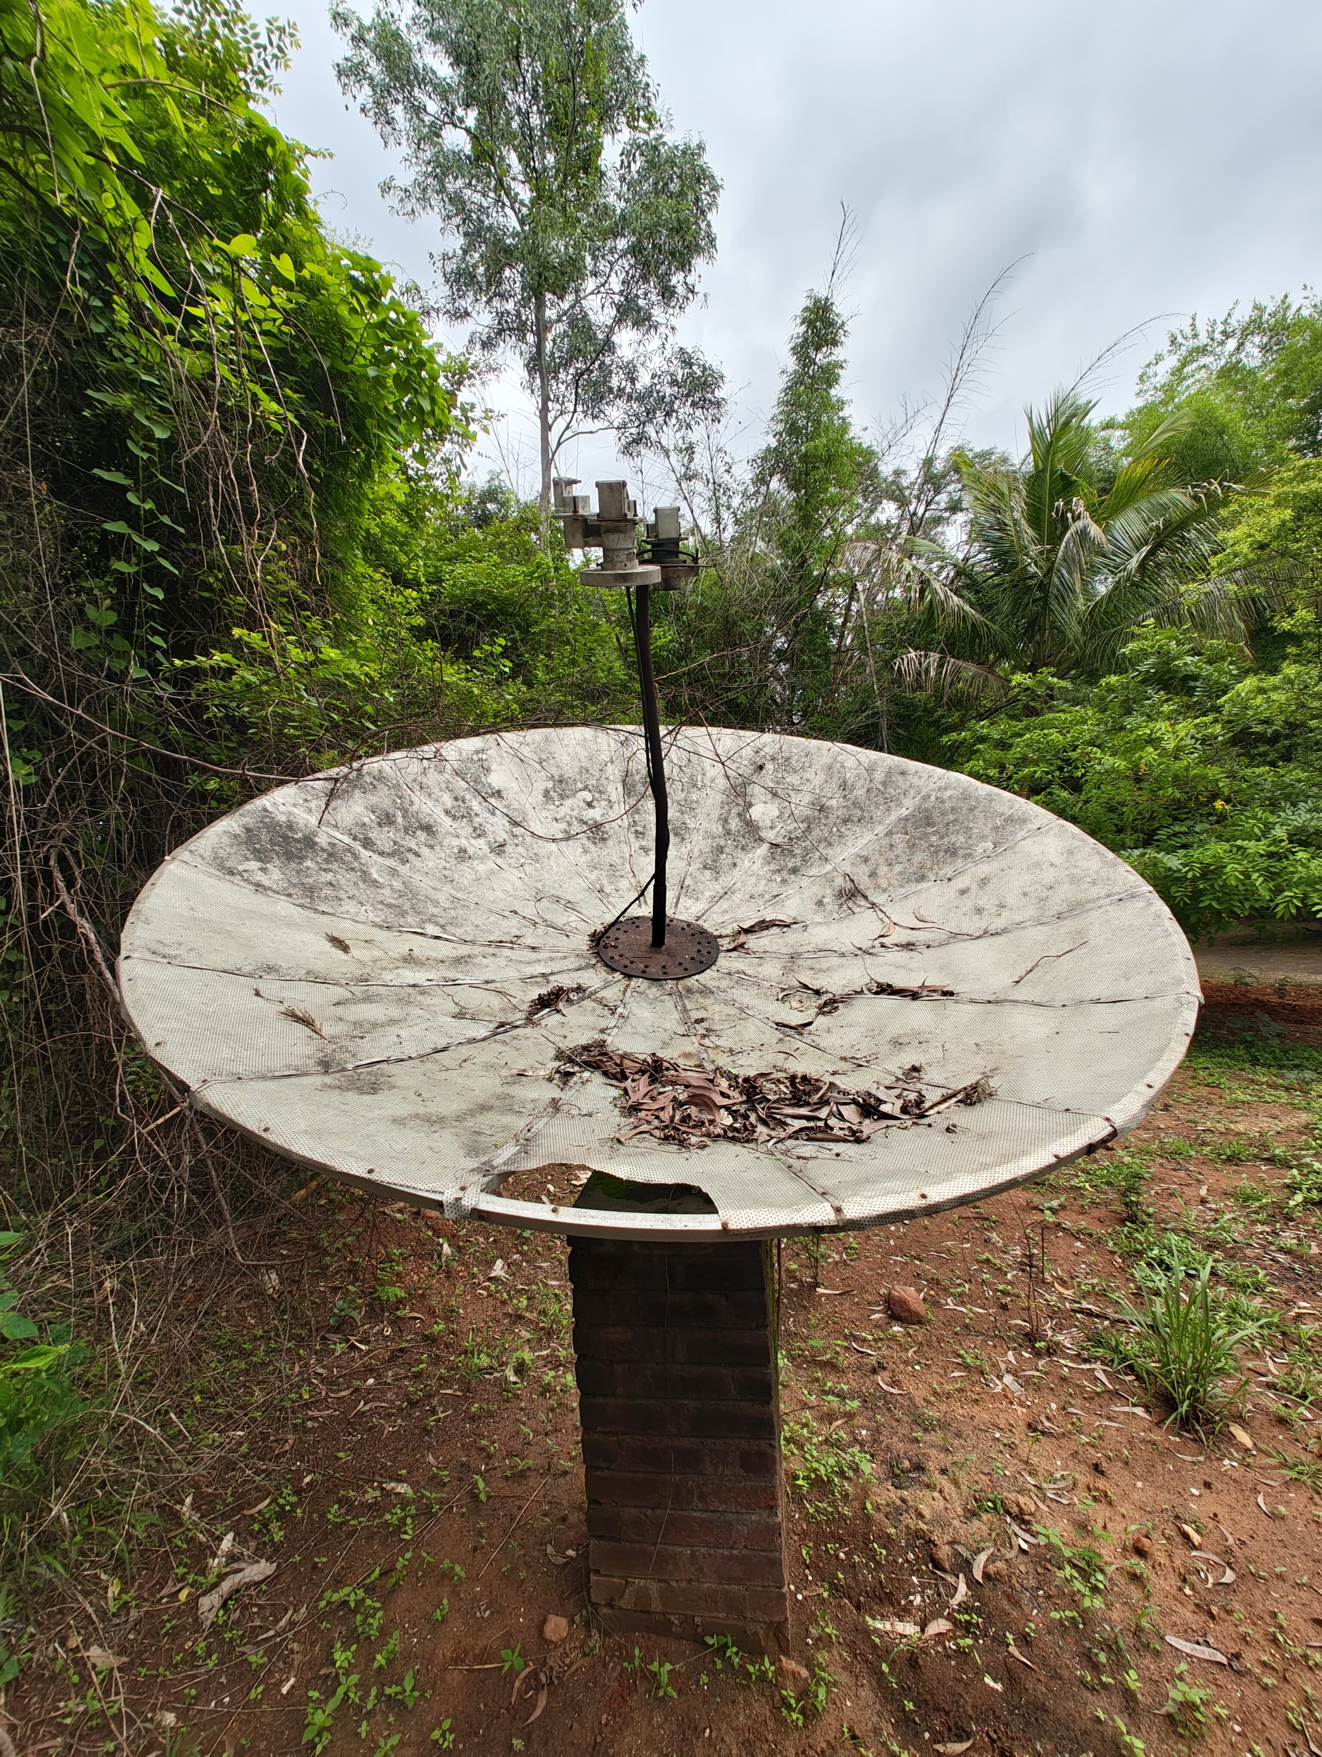
The needle in the haystack

Slide 5
The struggle
For a year, we struggled to get things done, finding the perfect aluminum sheet, pipes, feed,getting the rtl sdr, the LNA, and so many small things
We tried to use the same sheets but..[xrd]
New sheets, new lna, and everything
We had made 3d printed custom parts to hold things
But even after getting all the things…..

Slide 6
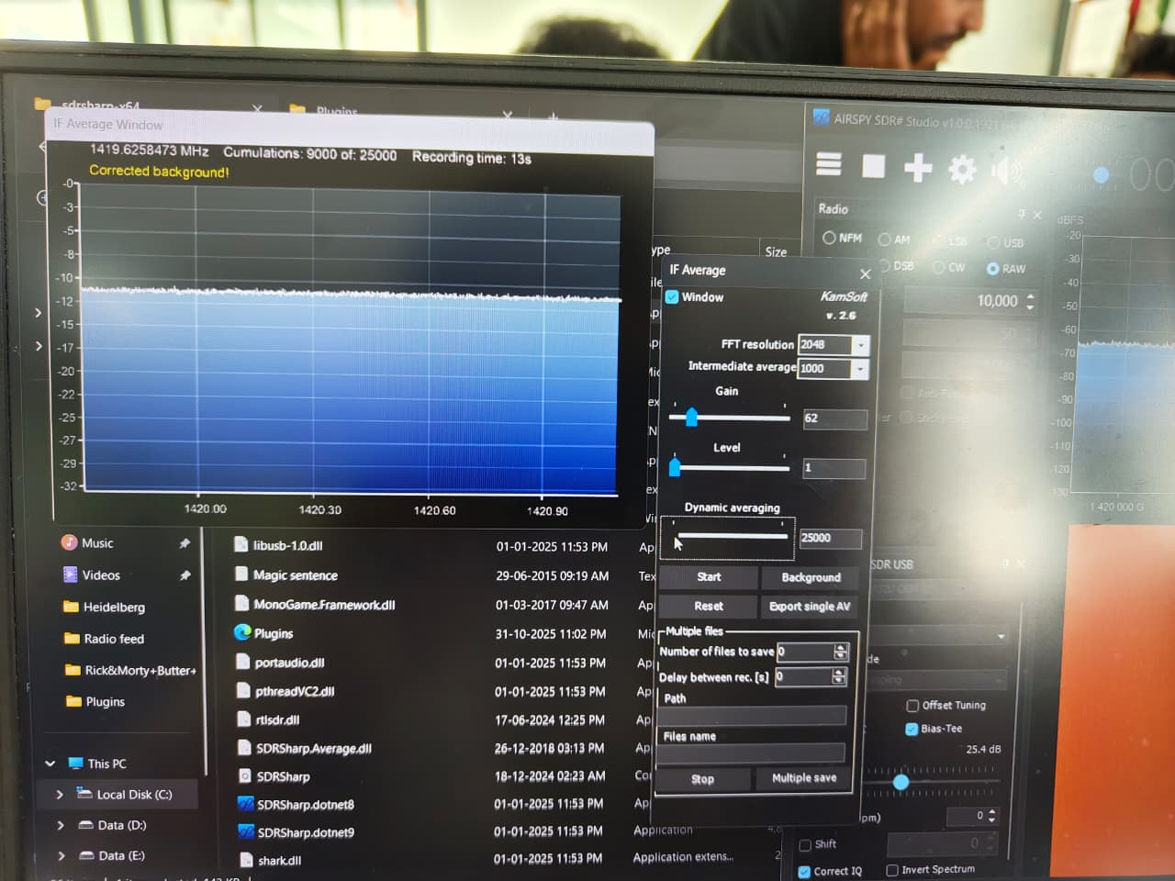
Struggle 2.0

Slide 7
Fresh struggle
We started fresh by removing the 3d prints
We looked for better parts, got more new things
Recalibrated the pipes and the dish
And after lots of effort after almost 1year and 2months

Slide 8
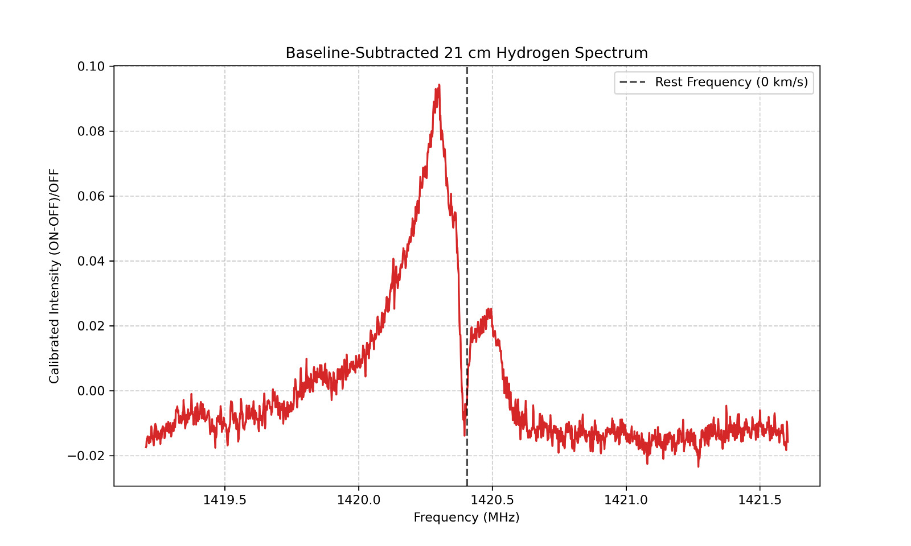
First light

Slide 9
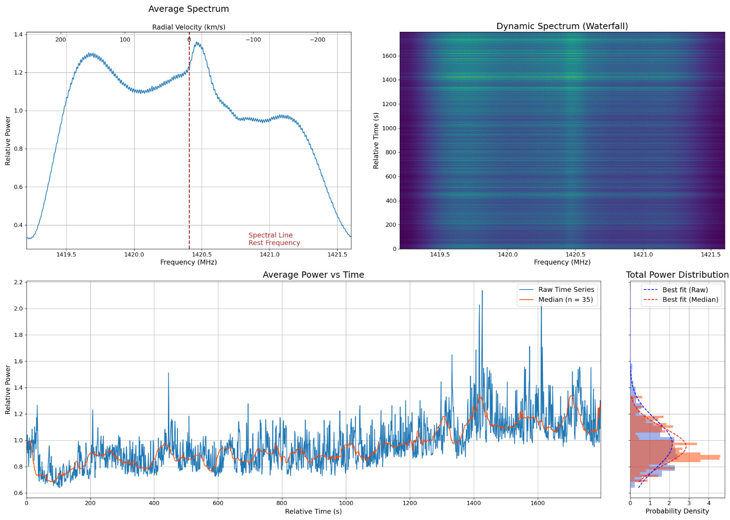

Slide 10
What next
We need to talk about it

